Slide 1

Regularization
The problem of overfitting

Slide 2
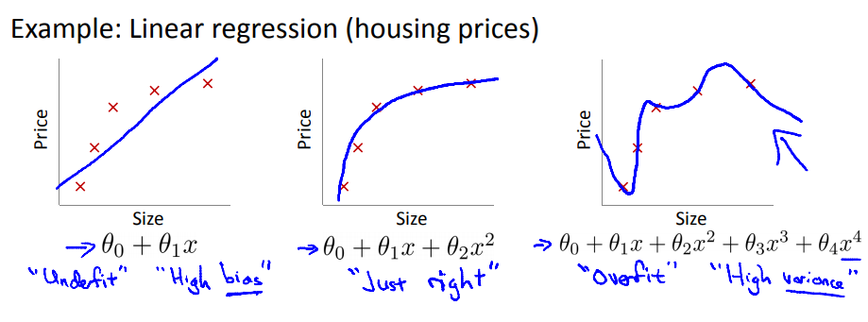
WHAT IS OVERFITTING ?
Overfitting: If we have too many features, the learned hypothesis may fit all the training set => J(θ) ≈ 0 but fail to predict on new examples

Slide 3
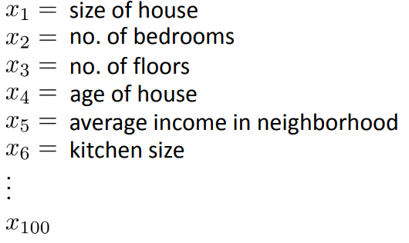
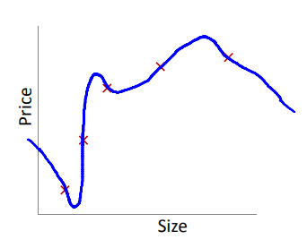
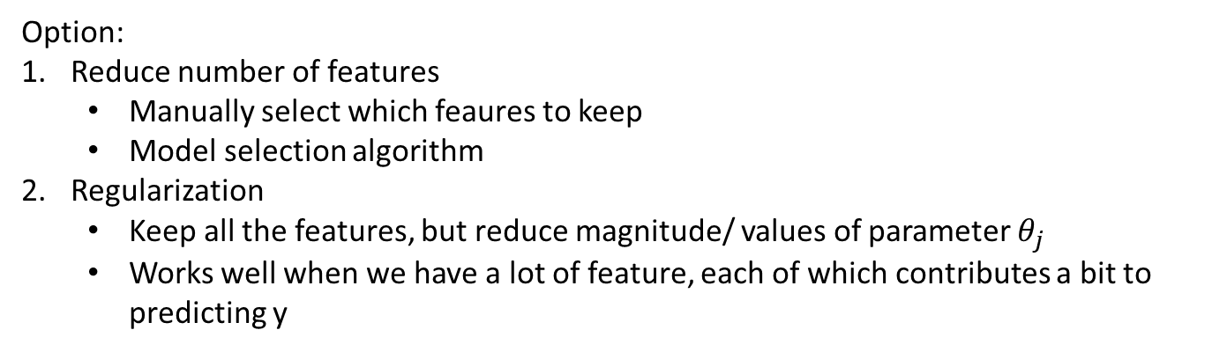
ADDRESSING OVERFITTING
Option:
Reduce number of features
Manually select which feaures to keep
Model selection algorithm
Regularization
Keep all the features, but reduce magnitude/ values of parameter $θ_{j}$
Works well when we have a lot of feature, each of which contributes a bit to predicting y

Slide 4
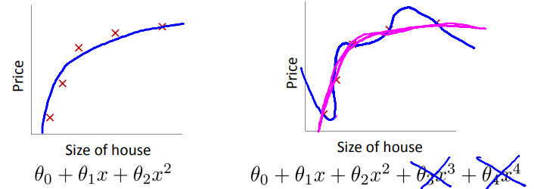
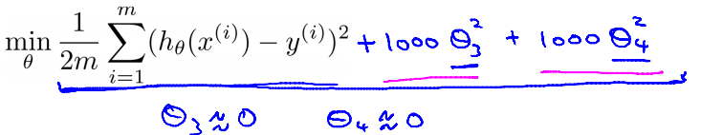
COST FUNCTION
Suppose we penalize and make $θ_{3},θ_{4}$really small

Slide 5
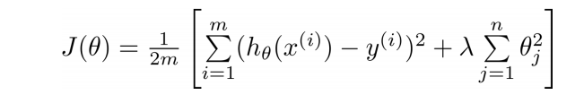
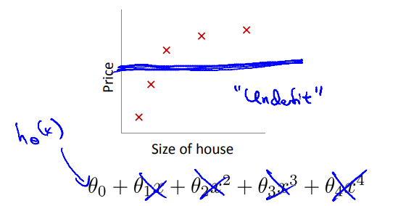
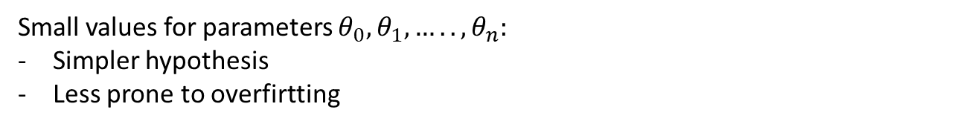
Small values for parameters $θ_{0},θ_{1},…..,θ_{n}:$
Simpler hypothesis
Less prone to overfirtting
Too big
Fails to eliminate overfitting
Gradienr descent will fail to converge

Slide 6
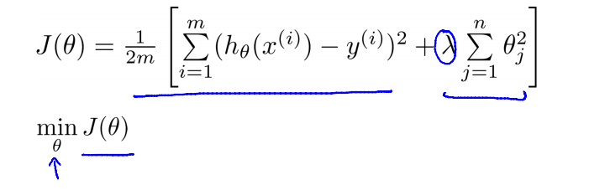
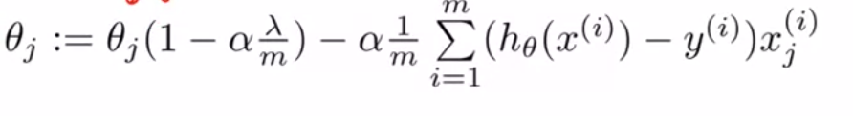
Regularized linear regression
Gradient descent

Slide 7
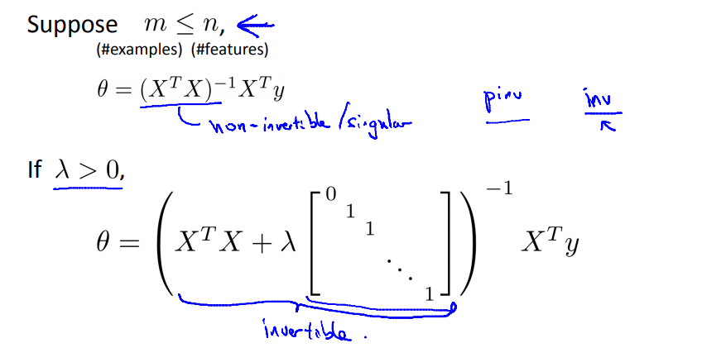
Normal equation

Slide 8
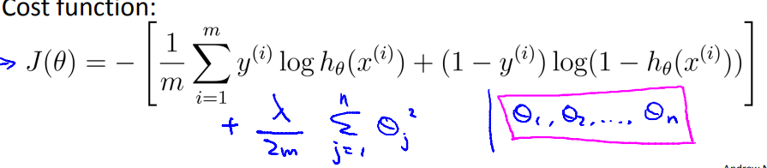
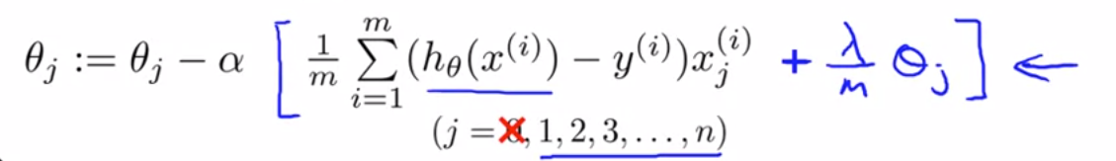
Regularized logistic regression
Gradient descent

Slide 9
Normal equation

